Slide 1
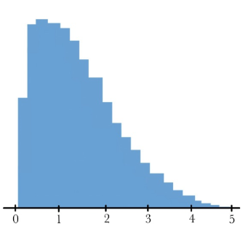
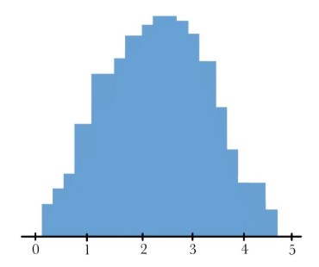
QFE Week 3-Hypothesis Testing
A
B
frequency
frequency
# salmon caught
# salmon caught
Discuss with classmates: We observed grizzlies in Alaska catching salmon over the course of a day. Histogram A shows the number of grizzlies that caught a number of salmon during the day. Histogram B shows the expected number of grizzlies that caught that number of salmon during the day. Do you think the grizzlies’ ability to catch salmon is “random” or do you think some grizzlies may be better or worse than others?
Notes:
Some sort of non-randomness going on!
But these are just random histograms I found on google images. Don’t pay attention to the actual graphs just the idea

Slide 2

Hypothesis Testing
Hypotheses: potential explanations for what we observe
Manipulative studies
Correlative/observational studies
Statistical treatment is identical
Distinction lies with inference
  When you are done, what can you say
Notes:
Can sometimes say more about manipulative studies than observational ones – by creating treatments and randomly assigning groups, you can reduce confounding/bias.
For example, what is the effect of an animal missing a limb on reproductive success (can they find a mate if they are missing a limb) – you may have the ability to randomly assign groups and remove limbs from a set of animals, but that often is not ethical, so you may choose to do an observational study. However, there may be confounding variables in these observations that you would not have if you did the manipulation.

Slide 3
To test our hypotheses, we need to take samples!
Purpose: ecologists want to collect quantitative information about something
Biological Population: aggregation of individual organisms of a single-species in a given area
Statistical Population: entire set of data of interest
Statistical Sample: measured portion of subset of the statistical population
Notes:
Biological Population and Statistical Population may be the same or may be different.
A biological population could be “common dolphins in the Chesapeake bay”
ASK: what if I wanted to know the weights of juvenile dolphins? Would that align with or be a subset of the biological population?
Then I would randomly sample some of the juvenile dolphins – that would be our statistical sample.

Slide 4
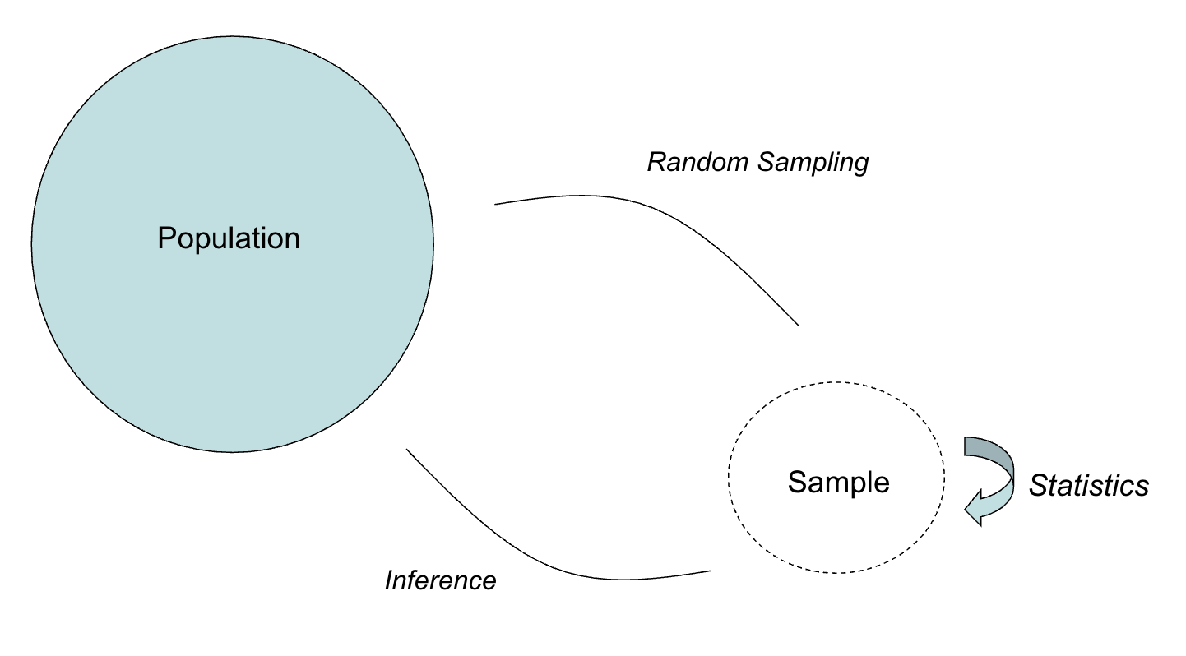
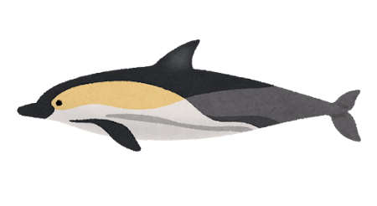
Notes:
We have a population (juvenile dolphins in the Chesapeake bay) and we take a random sample of those to get our statistical sample. We do some statistics on our sample, and then we can make an inference about the population! (i.e., being confident that the interval of 45 to 65 kilos contains the true population mean weight of juvenile dolphins)

Slide 5

Selecting Samples
Bias: when some members of the population are more likely to be sampled than others
Random Sampling: allows for legitimate conclusions to be made
Allows use of probability theory to generate chances of error and accurate variance estimation
Methods of randomly selecting samples:
Flip coin
Draws from a hat
Hundredths place on stopwatch
Random number table
Notes:
Give a bias example! Crayfish, phone surveys
Those probability distributions are what underpin lots of statistical tests and they require our samples to be random to use them – they just assume that things are random and if they aren’t, things can go haywire and your results aren’t legit. (reasoning – drivers tests/cars?)

Slide 6
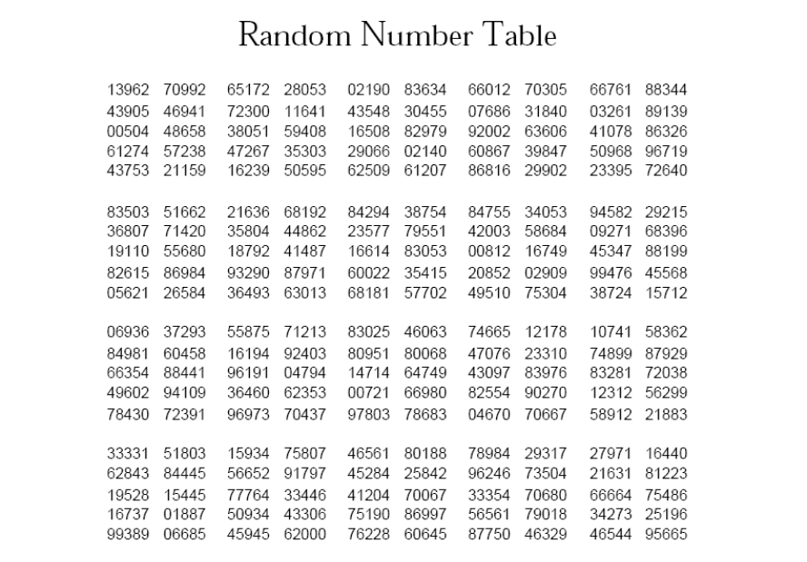
Notes:
Do an example with everyone with this! Bring in little squares of paper!
Number the class: 01-18 (can hand everyone a number when they come in or whenever really)
Point to number on the table and start reading 2 digit numbers from there
Try to get 3-4 off of the table – will have to reject a lot of numbers here lol but can point out that’s why we don’t use random number tables a lot anymore

Slide 7
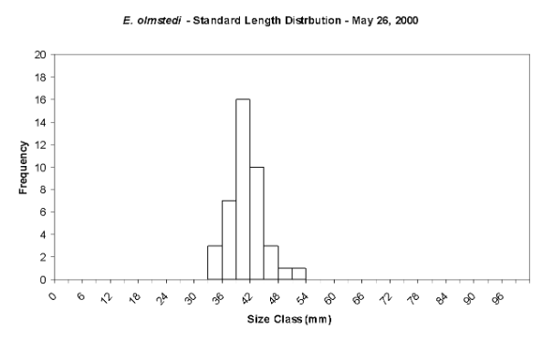
Replication
Measurements vary
Estimate central tendency
Error in estimate
Notes:
You do a lot of replicates (you can measure the weight of a bunch of dolphins) and their weights will vary.
You then estimate the mean, and there is some error within that estimate

Slide 8
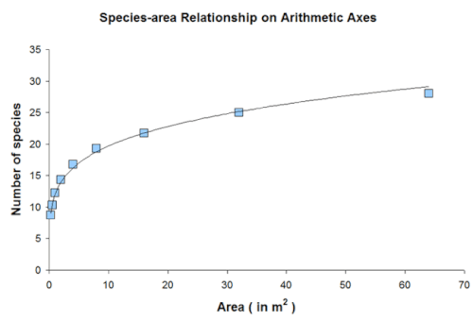
How do you know if you have enough samples?
Ex. Species area curve
Cumulative number of species plotted against area
Plateaus – larger amounts of effort yield fewer and fewer new species
Notes:
We will talk more when we get to making experiments and a further discussion of power

Slide 9
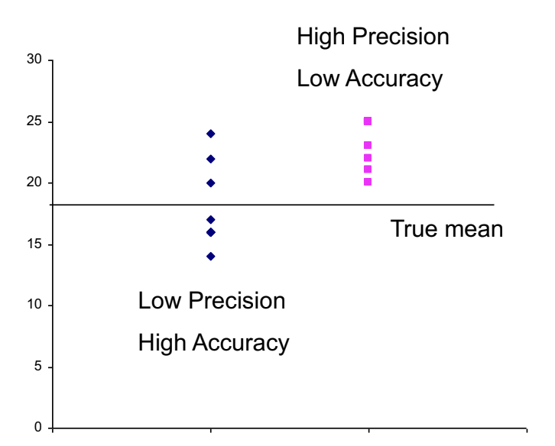
Accuracy vs. Precision
Accuracy: closeness of a measured value (estimate) to its true value (parameter)
Precision: closeness of repeated measurements of the same quantity to each other
Notes:
Something to think about while you are taking samples

Slide 10
Accurate, Precise, Both, or Neither?
I want to buy a scale for my lab, and I have 4 options. I’m testing them by weighing a 20 gram weight five times.
Gave readings of 24, 24.1, 24.2, 24, and 23.9.
Gave readings of 10, 15, 9.2, 12, and 3.
Gave readings of 20.1, 20, 20.1, 19.9, and 20.
Gave readings of 19, 20.5, 21, 18.8, and 20.5.
Which scale should I buy?
Notes:
Have them talk about in their groups which scale is accurate, which is precise, which is both, and which is neither, about 30-45 seconds. Then ask group 1 to share what scale 1 was, etc.
1 = precise, 2 = neither, 3 = both, and 4 = accurate.
I should buy scale 3.
Mention that sometimes scientific instruments that are super precise and accurate are $$$$, which one should I buy if I’m on a budget? Scale 4.

Slide 11
Statistical Analysis
1. Collect data
2. Does it look like there is a pattern?
3. Could the ‘pattern’ be due to just random noise? Compare your data to the pattern expected if there’s nothing going on
4. Draw conclusions, ask more questions.
Hypothesis testing compares data to what we would expect to see if a specific null hypothesis were true.
Hypothesis testing!
Notes:
*i.e., your treatment groups AREN’T different, there is NO relationship between the variables, etc…

Slide 12
Statistical Hypotheses
  Null hypothesis: a specific claim about the value of a population parameter.
    No pattern - No difference between groups, no relationship between variables
  Alternative Hypothesis: usually represents all other feasible parameter values except that stated in the null hypothesis
    Pattern exists - Difference exists, relationship evident
Notes:
Null hypothesis would be interesting to reject

Slide 13
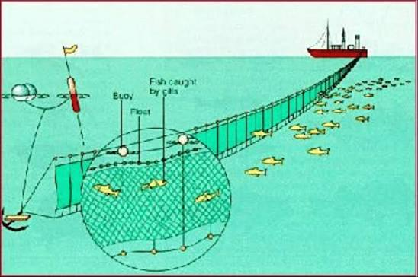
Hypotheses: Example
I want to study the impact that drift net fishing has on dolphins. I’m taking a look at the density of dolphins in places that have drift nets, and places that don’t.
What is a null hypothesis I could state about dolphin density?
What is an alternative hypothesis I could state about dolphin density?
Notes:
ASK the questions on the board!
The density of dolphins is the same in areas with and without drift-net fishing.
The density of dolphins differs between areas with and without drift-net fishing.

Slide 14
Hypotheses: Another Example
A null hypothesis can also represent an expectation from theory or from prior knowledge.
H₀: The mean body temperature of healthy humans is 98.6°F.
H_{A}: The mean body temperature of healthy humans is not 98.6°F.

Slide 15
The P-Value
The P-value is the probability of obtaining the data (or data showing as great or greater difference from the null hypothesis) if the null hypothesis were true. 0 ≤ P-value ≤ 1
Remember, in the world of the null hypothesis, everything is the same, treatments don’t have effects and there are no relationships between variables
So if there’s a high probability of getting your result, you probably live in the null world—it’s not that weird or surprising for that world.
But if your result is very unlikely in the null world (low probability of that result), then we can reject the null hypothesis
Notes:
If the P-value is large, Very likely to have observed the difference if the null were true
If the P-value is small, Unlikely that the observed differences could have been observed if the null were true

Slide 16

Statistical Significance and P-Values
Example: Comparing Means
Stress in mammals (GC hormone level in blood)
  - snowmobiles – 827 ng GC/g
  + snowmobiles – 1468 ng GC/g
Is the difference (1468 – 827 = 641 ng/g) big enough?
Do a statistical test
  Test statistic
  Associated probability value (P-value)
If I find a P-value of 0.7, do you think I should reject the null? What about a P-value of 0.01?
Notes:
“The control and treatment groups differed significantly from one another (P = 0.01)”

Slide 17
Statistical Significance and P-Values
Null Hypothesis (H₀)
Differences represent random variation between groups and do not reflect any systematic effect of snowmobiles
  Differences between groups are no greater than we would expect due to random variation
Alternative Hypothesis (H_{A})
Difference between groups is too large to be accounted for by random variation

Slide 18
Statistical Significance and P-Values: Summary
Group differences are assessed by taking the difference in some statistic (e.g., sample mean) and standardizing it by some measure of variation (pooled standard error)
(Mean amount of stress hormone in blood)
A statistical test is applied to this calculation, and a P-value generated
Calculate test statistic and P-value (0 ≤ P-value ≤ 1)
P-value is used to make the decision to reject/fail to reject the null
Notes:
Usually we just look at the test statistic if we calculate by hand and that will tell us if we are smaller or larger than a given p value
A computer can give us the actual p value!

Slide 19
P-Value Calculation
Depends on three items:
Sample size
Difference between the sample means
Variance among individuals
When is the P-value small enough? Decide a priori...
Usually, 0.05
Notes:
A priori = in advance

Slide 20
Test Statistic?
The test statistic is how we relate the data to some probability distribution function
Calculated to represent the match between a set of data and the null hypothesis
If the test statistic is too extreme, the null hypothesis is generally rejected
For parametric tests, the test statistic is a random variable
There are nonparametric alternatives

Slide 21
Parametric Analysis - FYI
Based on assumption data follows some defined distribution
Normal distribution most common
Steps:
Specifying the test statistics
Specifying the null distribution
Calculating the tail probability
Notes:
Basically what weve been talking about so far

Slide 22
Parametric Analysis - FYI
Advantages
Uses a powerful framework based on solid probability theory
Disadvantages
May not be as powerful as other methods, particularly when the data does not fit the rules
Notes:
Nonparametric methods often don’t require data to fit a particular distribution, etc

Slide 23

Types of Tests
One-sample
  Test sample statistic against a fixed value
  H_{o}: μ₁ = μ_{o}
Two-sample
  Compare two groups
  H_{o}: μ₁ = μ₂
Multiple sample
  Compare > 2 groups
  H_{o}: μ₁ = μ₂= μ₃, …= μ_{k}
Notes:
Is an individual lizard smaller than the mean size of (a sample of) the current population from which it was sampled?
Is the (sample of the) population of lizards smaller/larger than a (sample of the) neighboring population?
Is the (sample of the) population of lizards smaller/larger than (a sample of) 6 populations from the state of Arizona?

Slide 24
Types of Tests
Two-sided
  H_{o}: μ₁ = μ₂
  H_{a}: μ₁ ≠ μ₂
One-sided – upper
  H_{o}: μ₁ ≤ μ₂
  H_{a}: μ₁ > μ₂
One-sided – lower
  H_{o}: μ₁ ≥ μ₂
  H_{a}: μ₁ < μ₂
In a one-sided (or one-tailed) test, the alternative hypothesis includes parameter values on only one side of the value specified by the null hypothesis. H₀ is rejected only if the data depart from it in the direction stated by H_{A}.
Notes:
You can do two sided tests, where your population parameter can deviate to either side of the value specified for the null hypothesis.
One sided-test: imagine a study designed to test whether daughters resemble their fathers. In each trial of the study, a participant examines a photo of one girl and photos of two adult men, one of whom is the girl’s father. The participant must guess which man is the father.
H0: Participants pick the father correctly half the time
HA: Participants pick the father correctly more frequently than half the time
We mostly use 2 sided tests: even when we predict that a result may go in a particular direction, we may still be tempted to interpret a result in the tail of the opposite direction as a significant deviation from the null hypothesis.

Slide 25
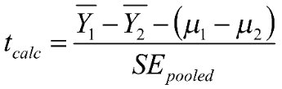
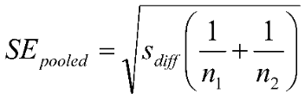
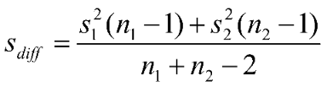
Standard Two-Sample T-Test
Somewhat complicated calculations – statistical programs and code will often take care of these for you!
By using these we assume that
  Samples are random
  Variable is normally distributed
  Standard deviation/variance is the same in both populations
Notes:
By complicated I mean it’s not that the math is hard it’s just that there are a lot of little pieces you have to pay attention to

Slide 26

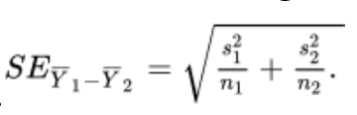
Welch’s T-Test
If there is more than a threefold difference in standard deviations, or if the sample sizes of the two groups are very different or less than 30 with some difference in standard deviations, then the Welch’s approximate t-test
Welch’s t-test is performed just like a two-sample t-test, with some modifications:

Slide 27
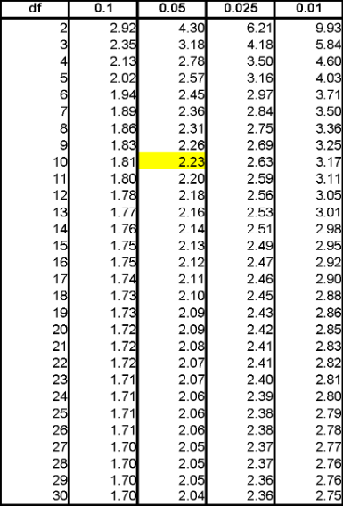
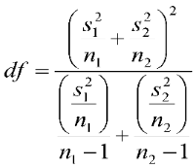
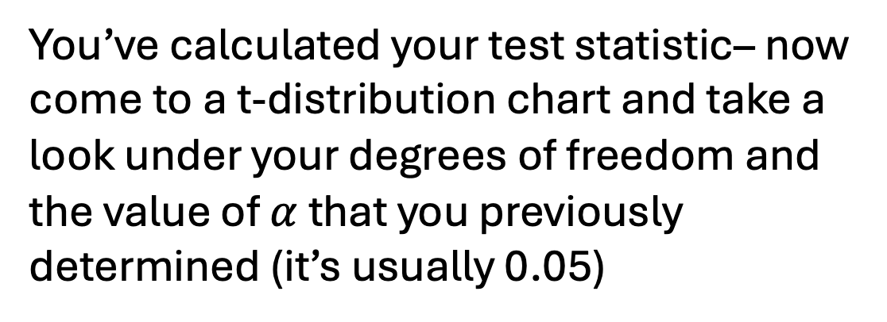
T-Tests
You’ve calculated your test statistic– now come to a t-distribution chart and take a look under your degrees of freedom and the value of $α$ that you previously determined (it’s usually 0.05)
Degrees of Freedom (df)
  Homogeneity of Variance
    n₁+n₂ – 2
  No homogeneity of variance (Welch)
If t_{calc} > t_{α,df,} then reject null
Notes:
Degrees of freedom: This formula need not give an integer value. For a given test, round the df calculated by this formula down to the nearest integer.
In the table, we have our highlighted value 2.23, so if we calculated a value of 2.41, we would say that our p value is less than 0.05 and reject the null hypothesis.

Slide 28

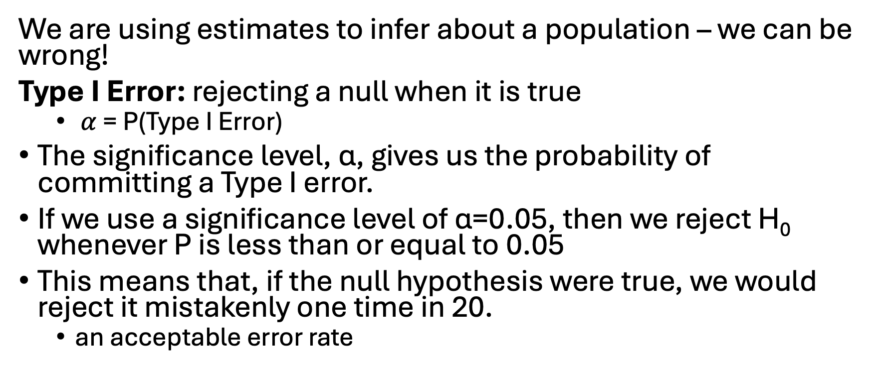
Errors in Hypothesis Testing
We are using estimates to infer about a population – we can be wrong!
Type I Error: rejecting a null when it is true
  $α$ = P(Type I Error)
The significance level, α, gives us the probability of committing a Type I error.
If we use a significance level of α=0.05, then we reject H₀ whenever P is less than or equal to 0.05
This means that, if the null hypothesis were true, we would reject it mistakenly one time in 20.
  an acceptable error rate

Slide 29
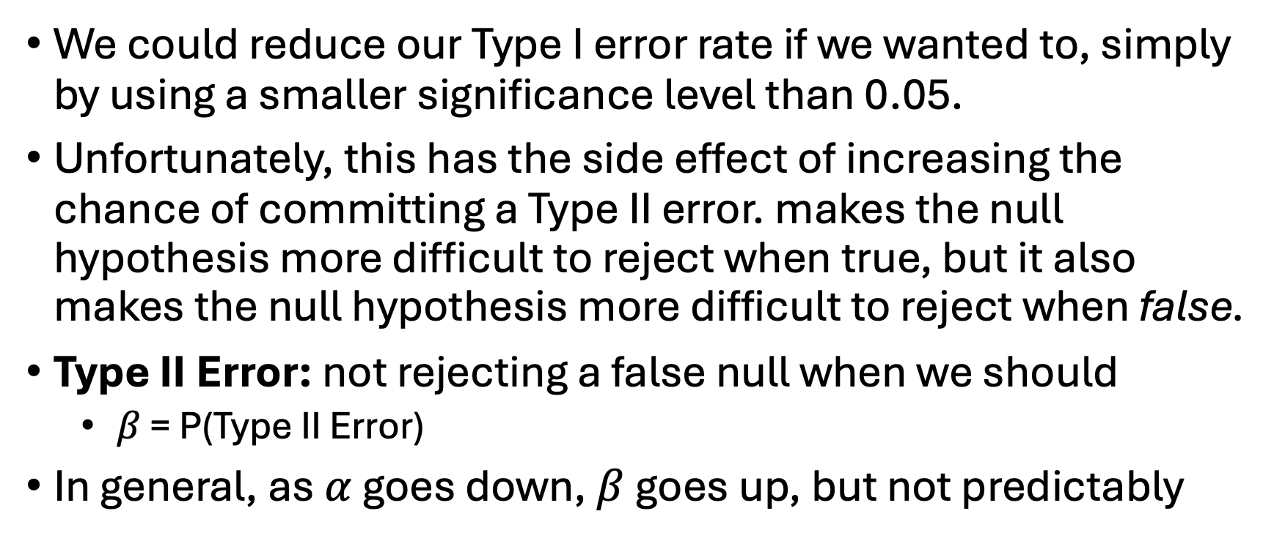
Errors in Hypothesis Testing
We could reduce our Type I error rate if we wanted to, simply by using a smaller significance level than 0.05.
Unfortunately, this has the side effect of increasing the chance of committing a Type II error. makes the null hypothesis more difficult to reject when true, but it also makes the null hypothesis more difficult to reject when false.
Type II Error: not rejecting a false null when we should
  $β$ = P(Type II Error)
In general, as $α$ goes down, $β$goes up, but not predictably

Slide 30
Power
A study that has a low probability of Type II error is said to have high power
Power is the probability that a random sample taken from a population will, when analyzed, lead to rejection of a false null hypothesis. All else being equal, a study is better if it has more power.
If we can guess the magnitude of the deviation from the null hypothesis, however, we can usually estimate the power of a study before it is carried out. A study has more power if the sample size is large, if the true discrepancy from the null hypothesis is large, or if the variability in the population is low.
Notes:
Probably will have more on power later in the semester!

Slide 31
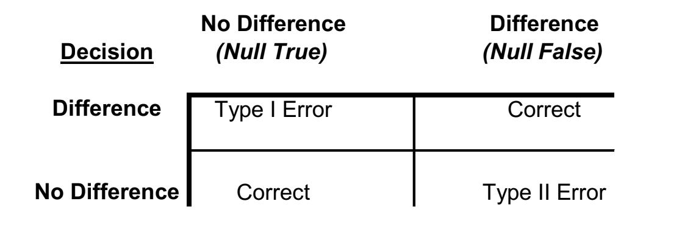
Error Summarized:
When I was studying my dolphins and drift nets, I rejected my null hypothesis, but in reality there was no difference in the density of dolphins in the two types of areas.
What type of error did I commit?
What would the scenario be instead if I was to commit the opposite type of error ?
Notes:
Type 1 error
I would have not rejected the null thinking there was no difference, but in reality there was a difference and the null was false

Slide 32
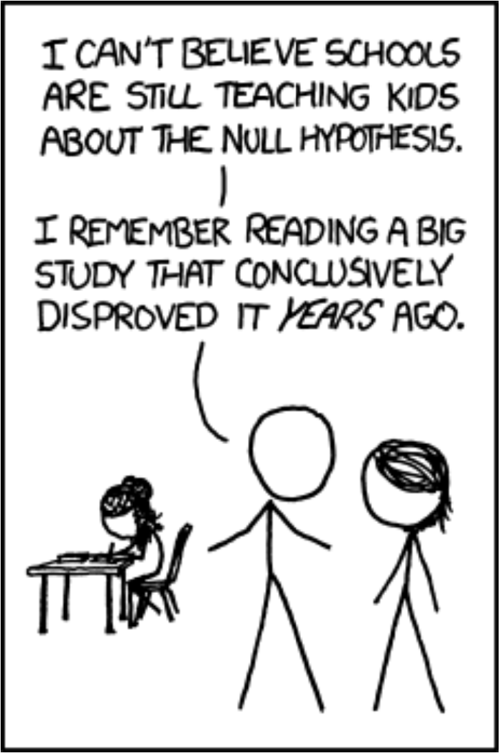
Lecture Exercise: Do a hypothesis test!
The exercise is available on Blackboard using Google Sheets -
Due 09/13 at 11:59 PM

